Slide 1
Haiti Mission Trip
March 13-March 21, 2011
Serve the People

Slide 2
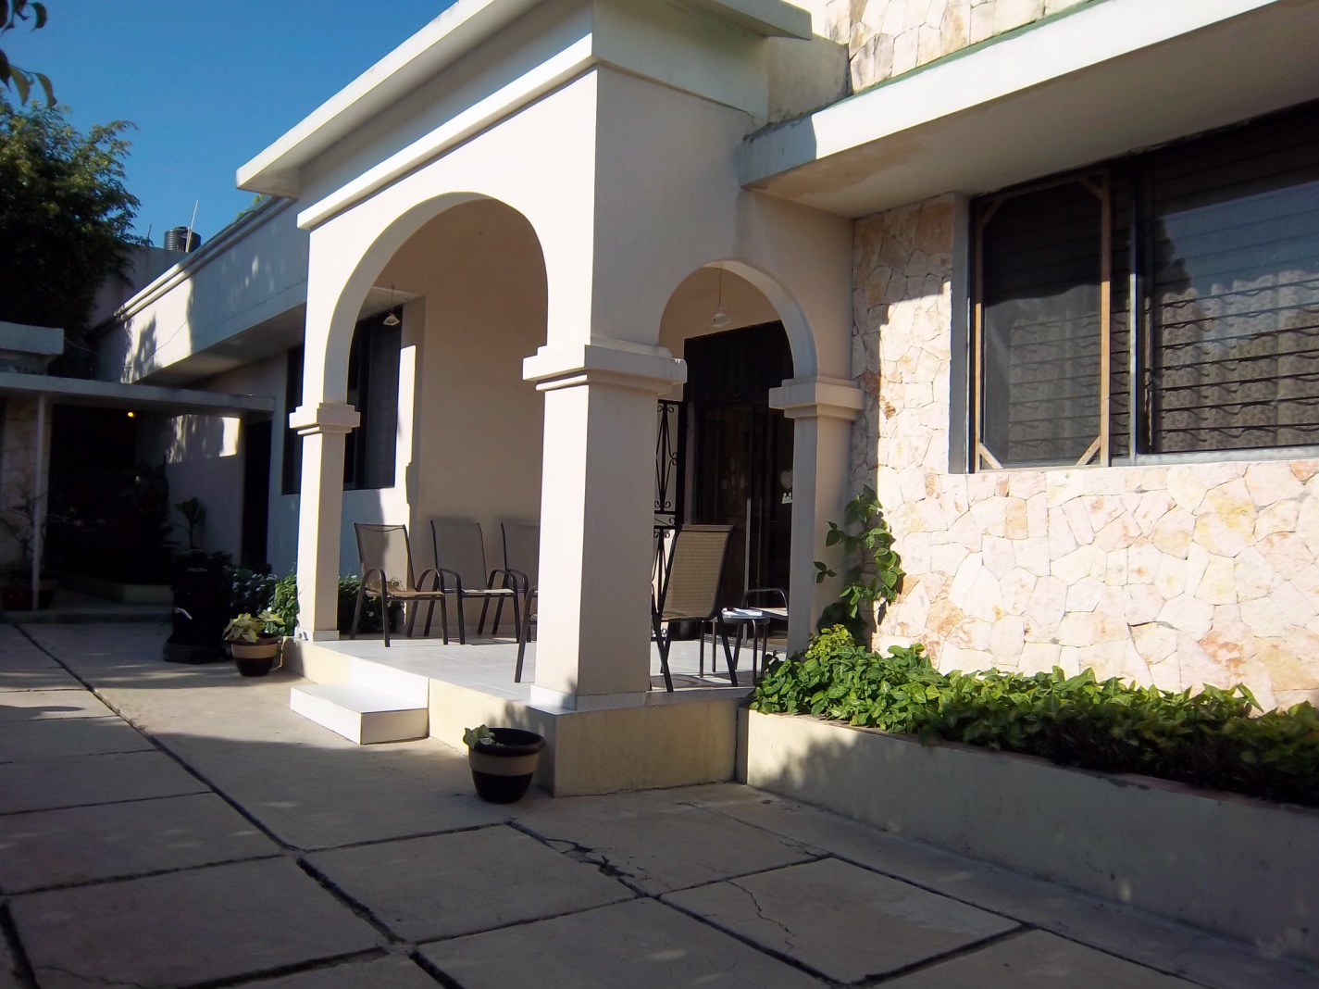
Guest House
This is the guest house where we stayed for the first two evenings (Dotty’s Guest House). This guest house is owned and operated by an American Women. Don Lyons, organizer of HUG (Haiti Under God), was a guest as well. HUG is a Christian organization sharing the love of God with the people of Haiti by feeding children, caring for orphans, and changing lives with the good news of Jesus Christ.

Slide 3
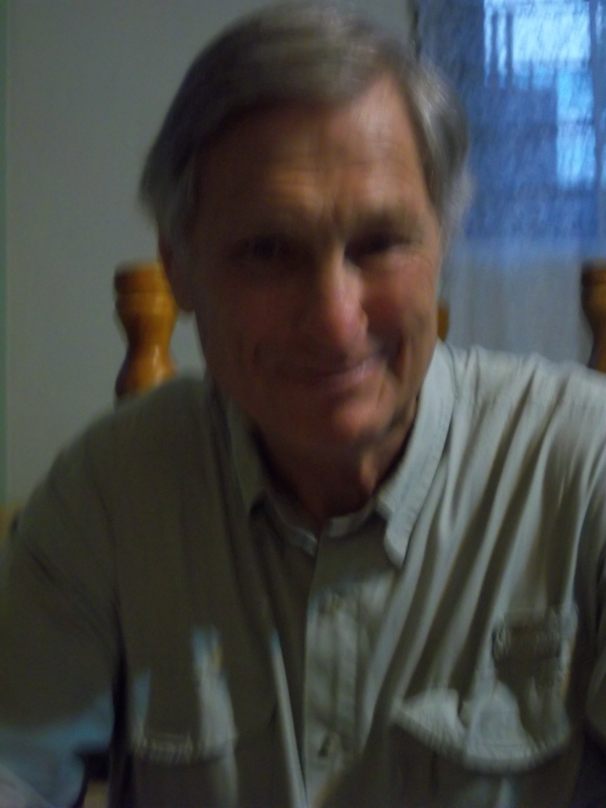
Don Lyons
Don helped with our projects on the first part of our trip working with HUG. We had nice visits with he and Sarah (from South Carolina) during our meals at the guest house.

Slide 4
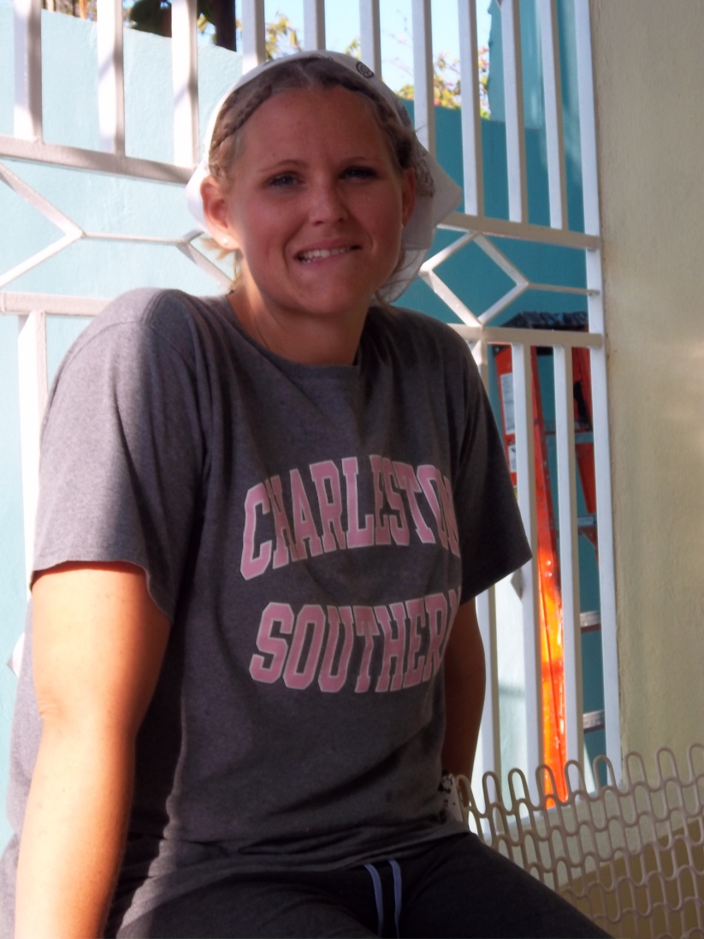
HUG
Sarah (from South Carolina) working with Don Lyons at the Girl’s AFCA Orphanage during their move.

Slide 5
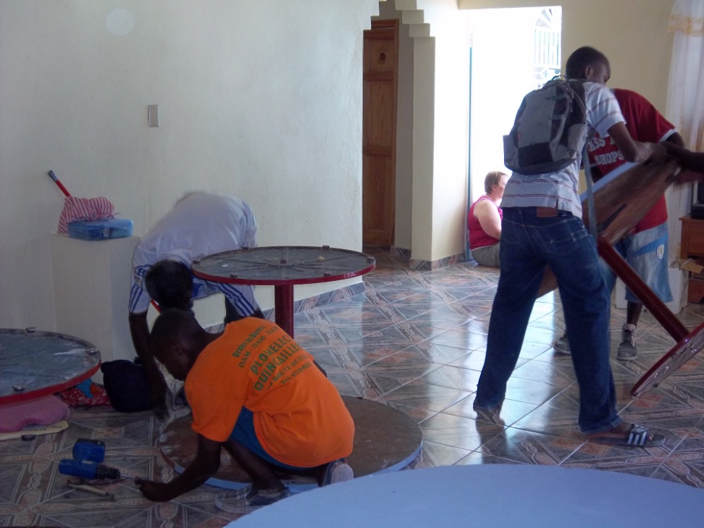
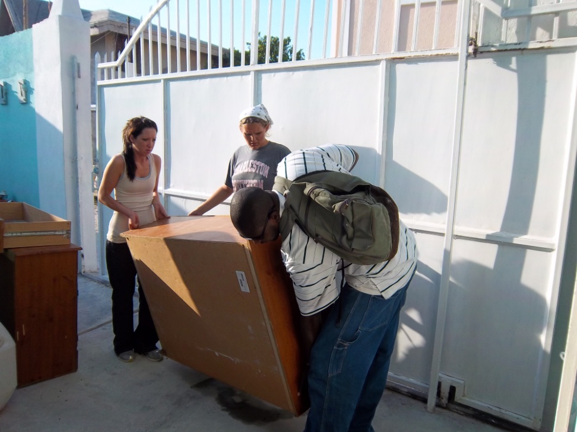
AFCA Girl’s Orphanage
Helping Move Into New Home

Slide 6
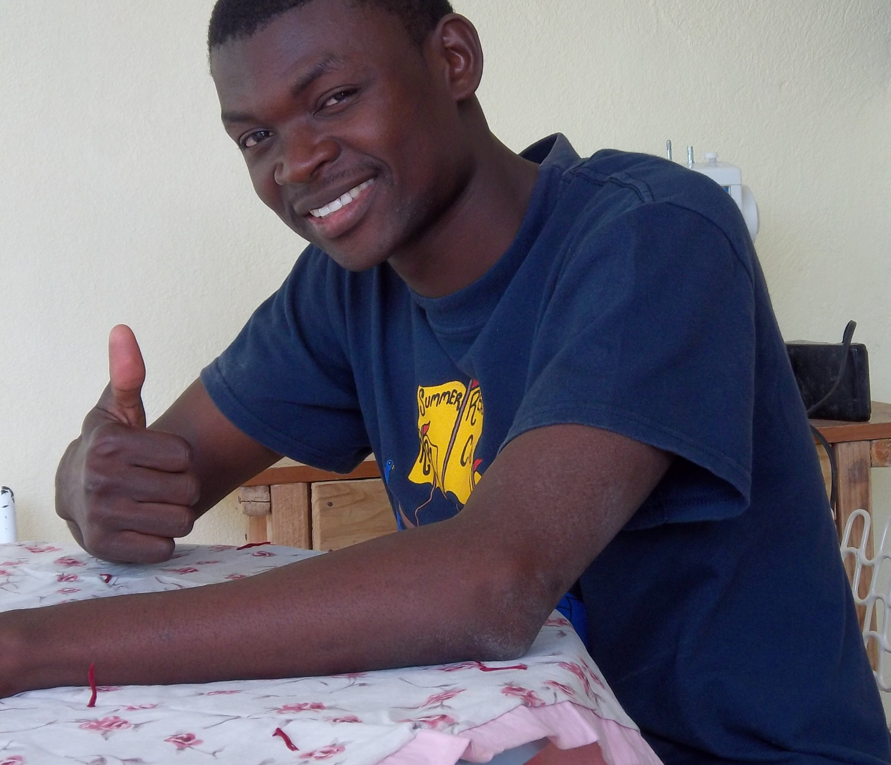
English Teacher
Smith is the girls’ English Teacher in the Orphanage. He is a great influence for the girls. He has a personality where he is able to discipline as well as have a good time with games and lessons.

Slide 7
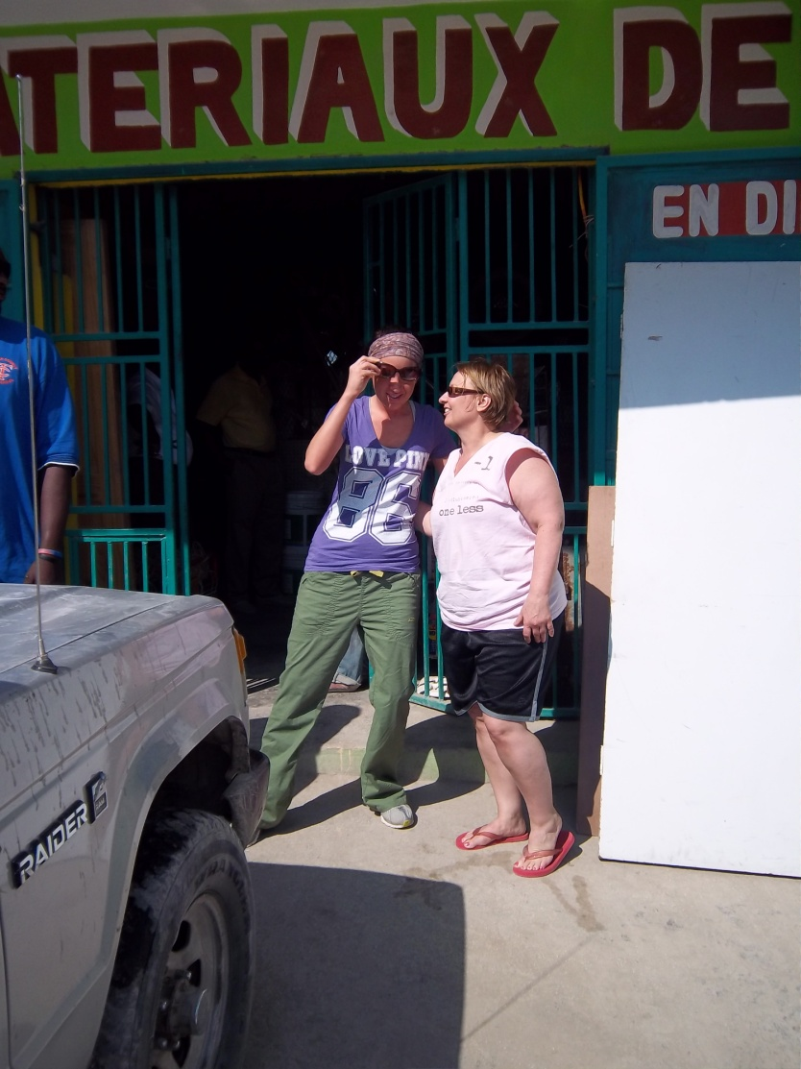
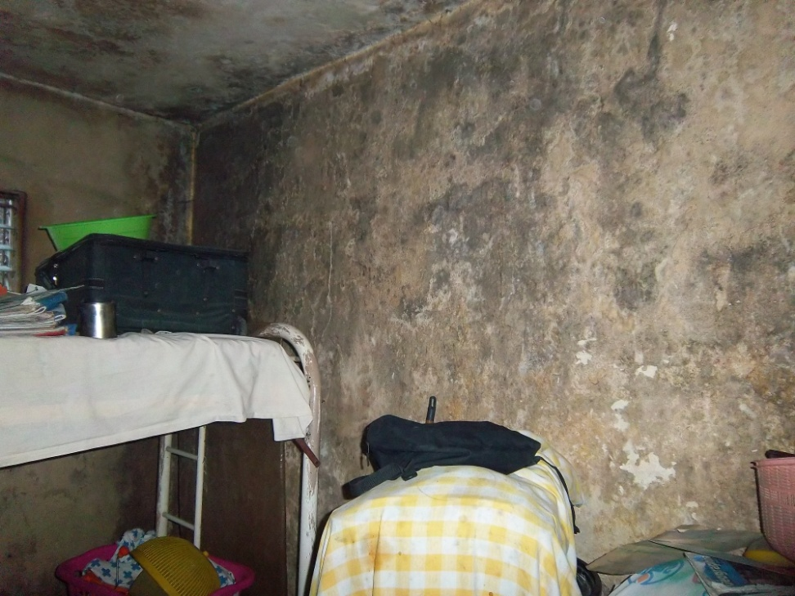
Aids Orphanage
Purchasing Paint.
Mold on walls of the bedroom.

Slide 8
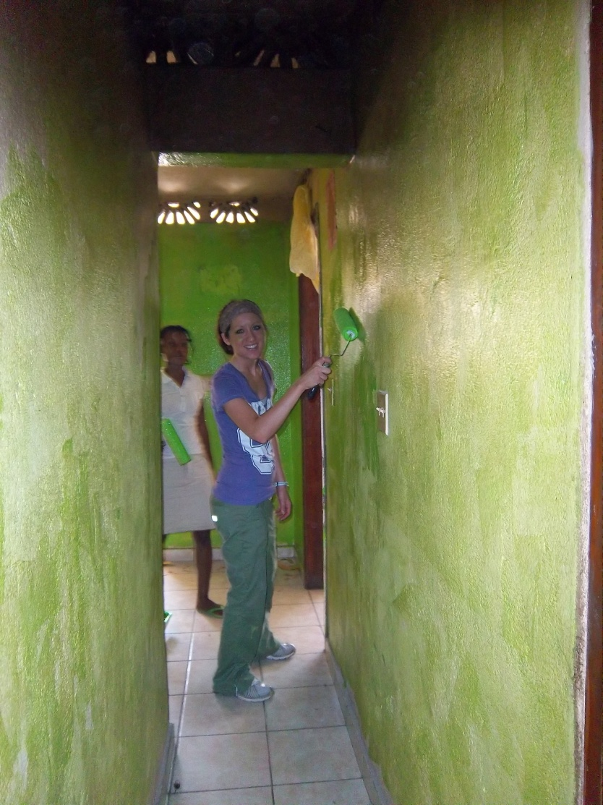
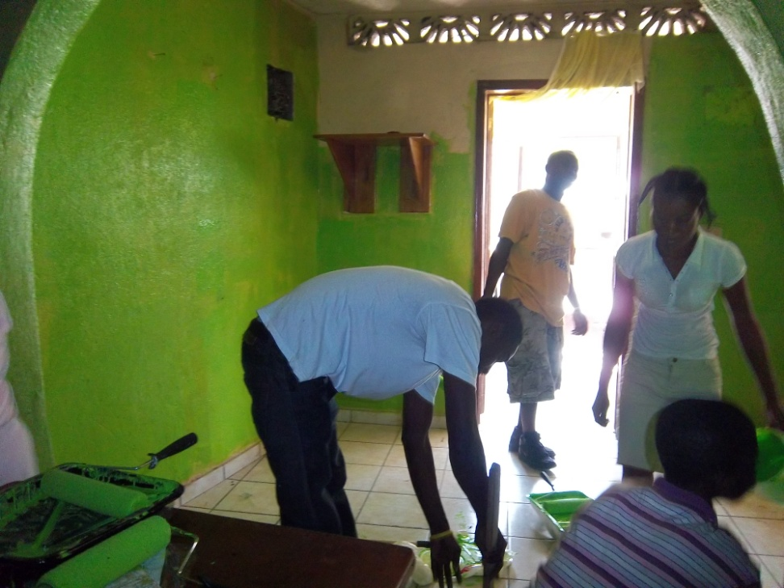
Painting at the Aids Orphanage

Slide 9
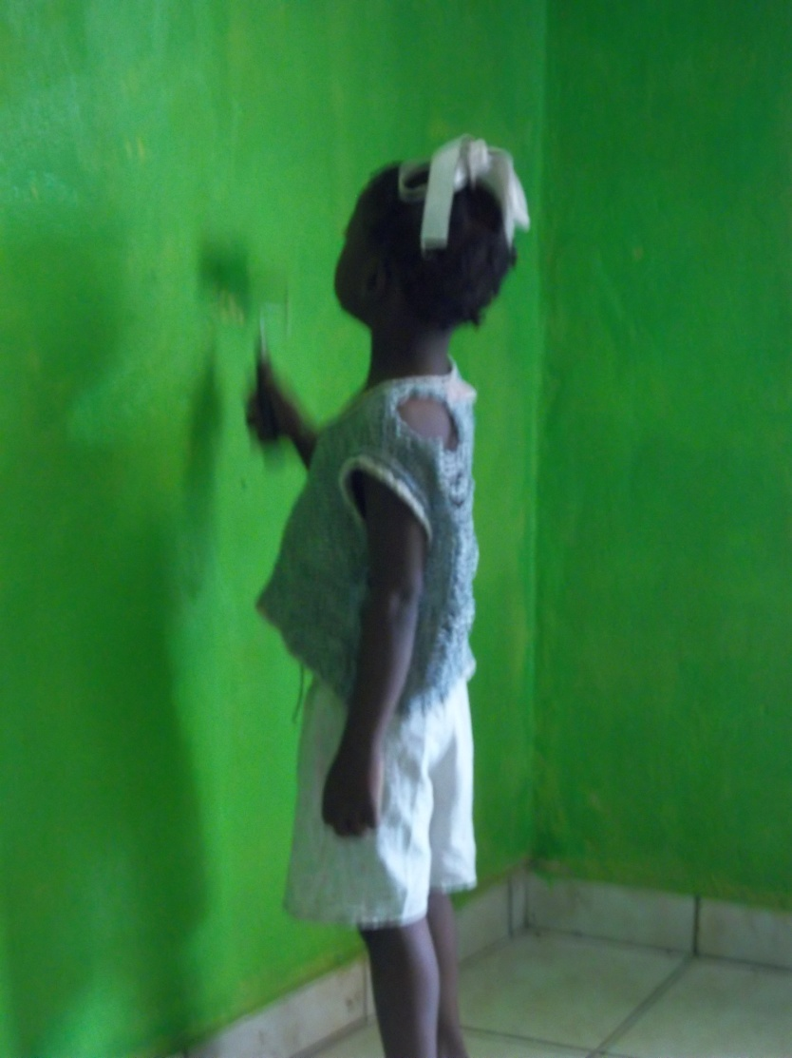
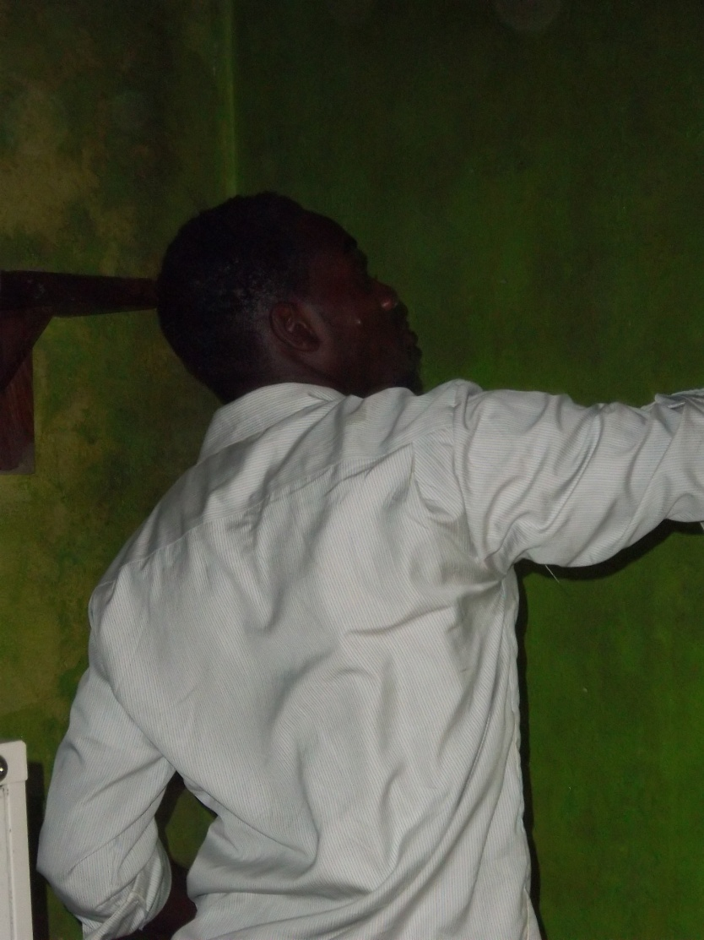
Help with Painting

Slide 10
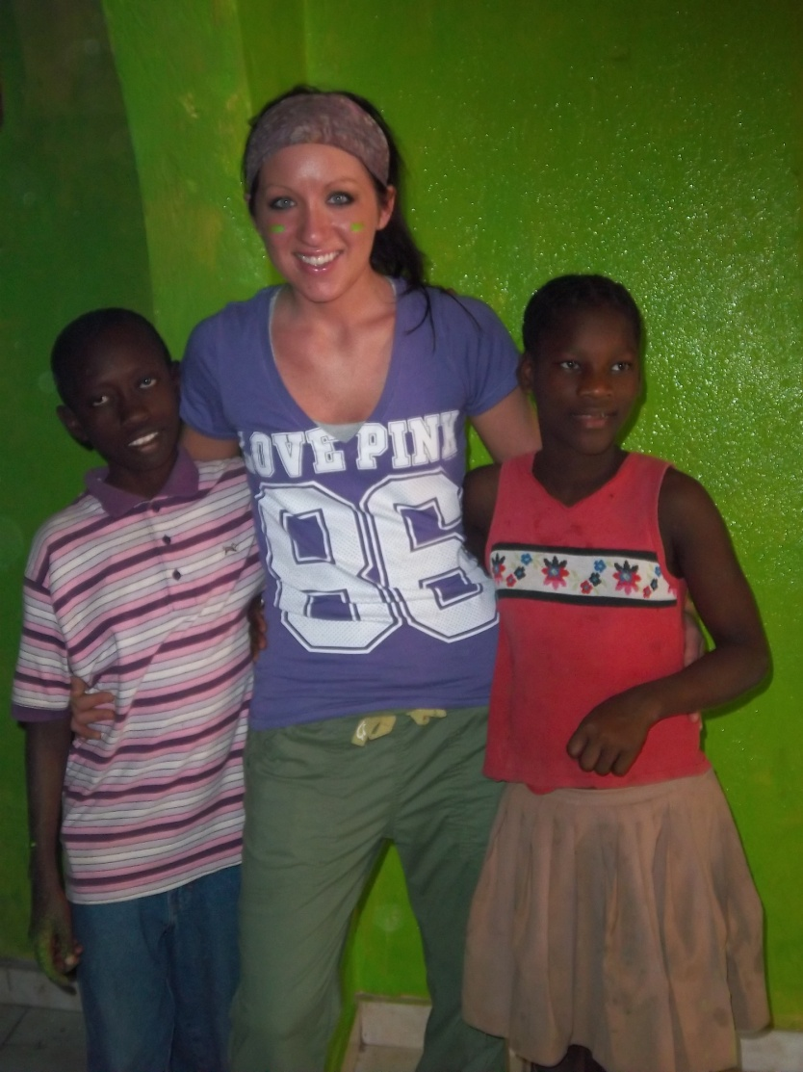
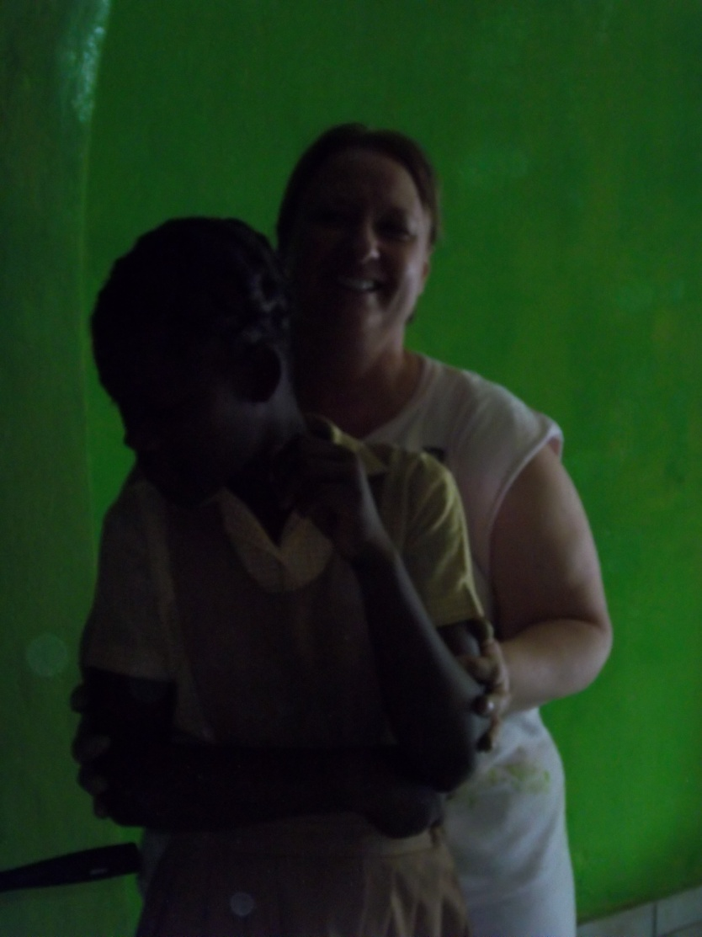
Friends at the Aids Orphanage

Slide 11
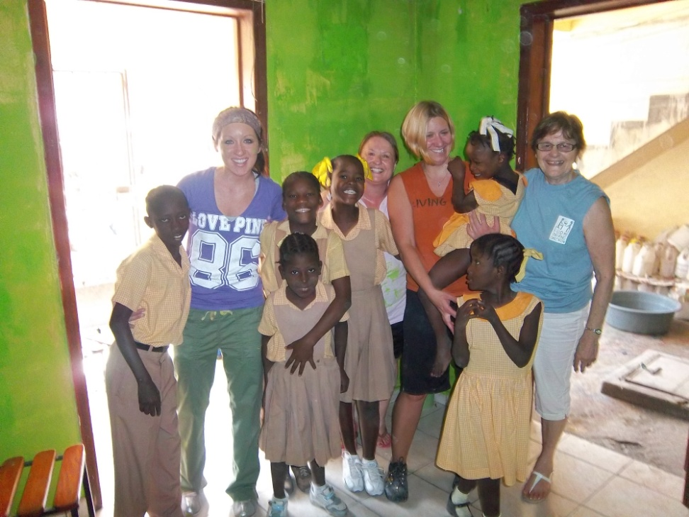
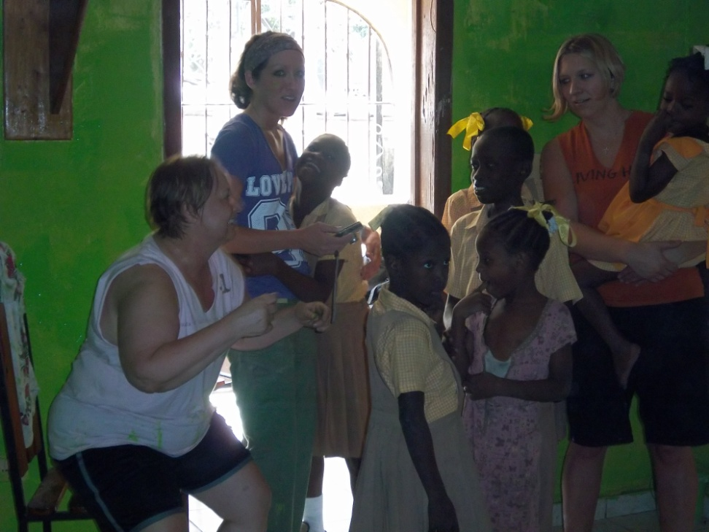
More Friends

Slide 12
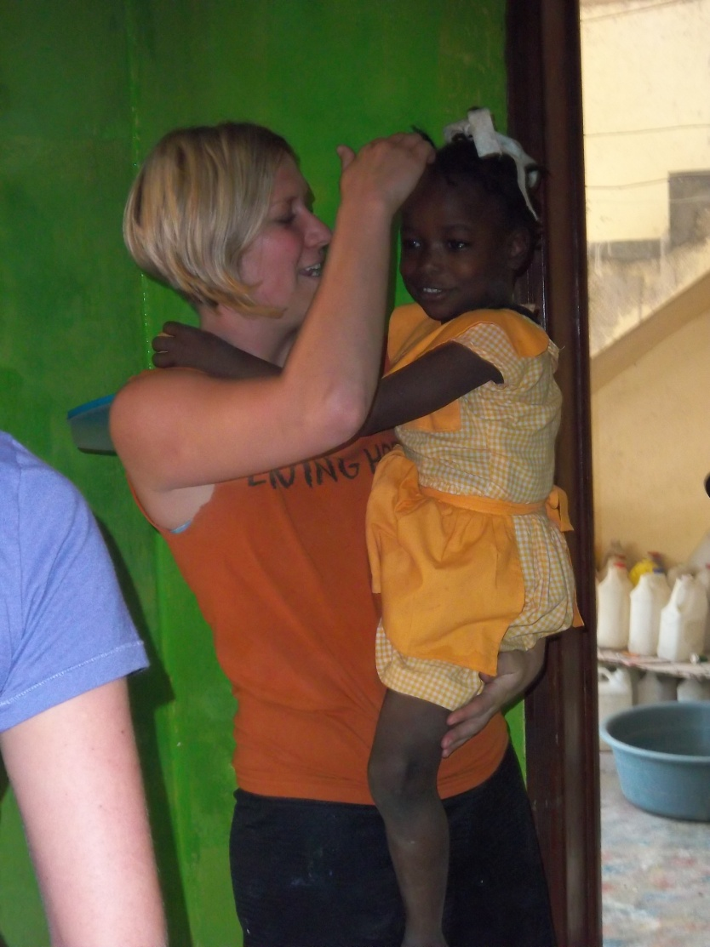
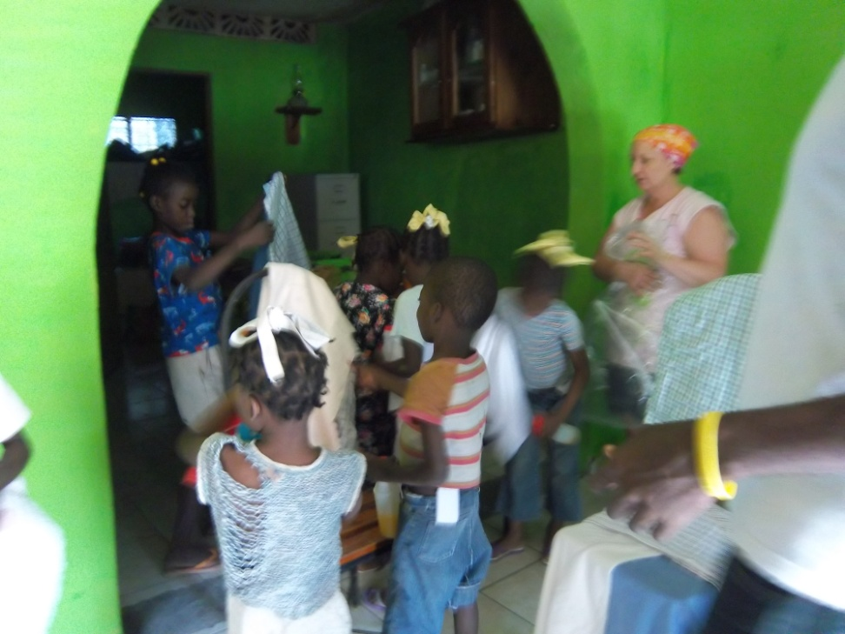
Relationships Formed

Slide 13
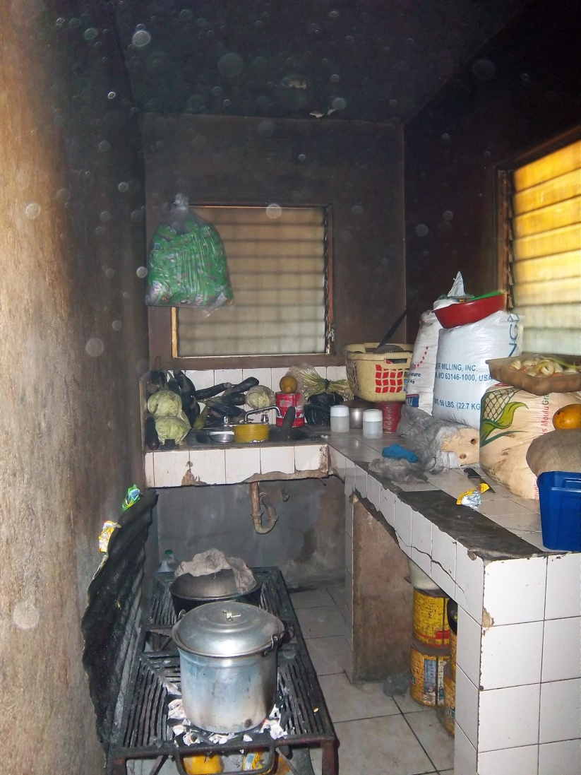
Kitchen at the Aids Orphanage
This is the kitchen at the orphanage. They cook over charcoal fires; hence, the smoke covered walls. They serve the food provided by Feed My Starving Children.

Slide 14
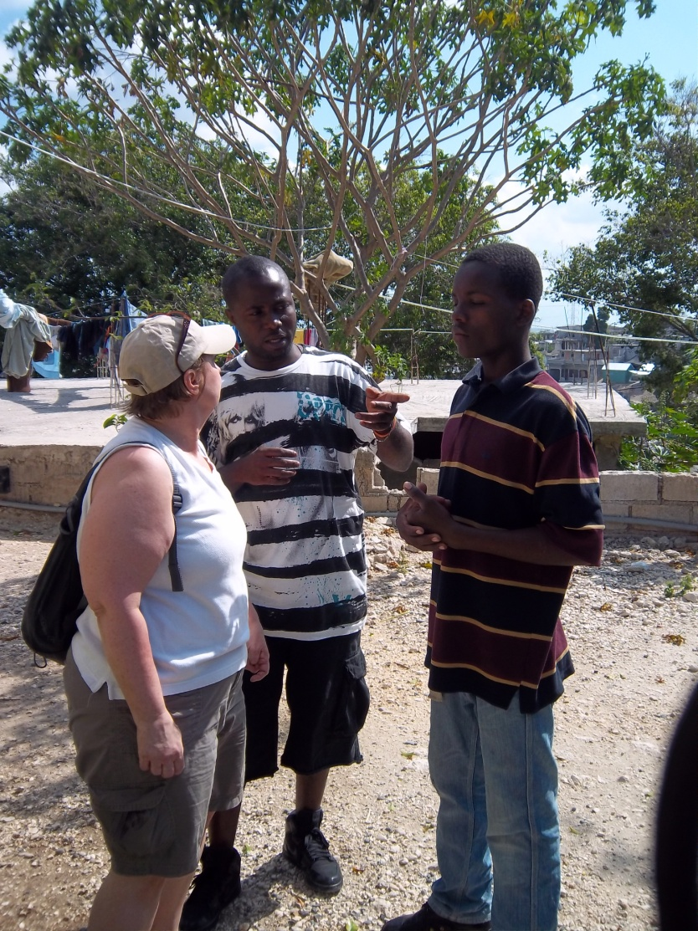
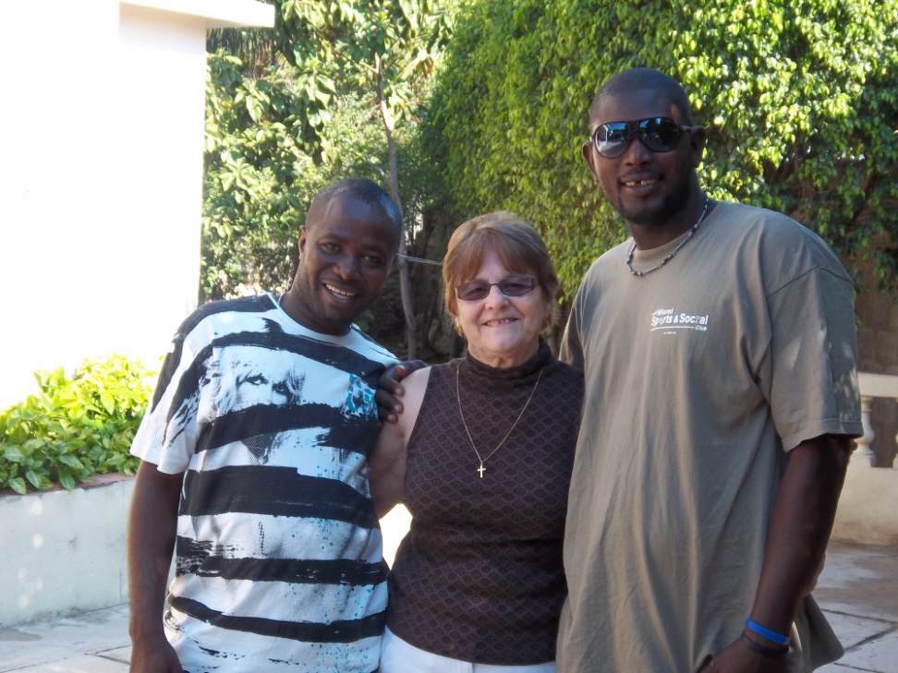
Interpretors (a huge support)

Slide 15
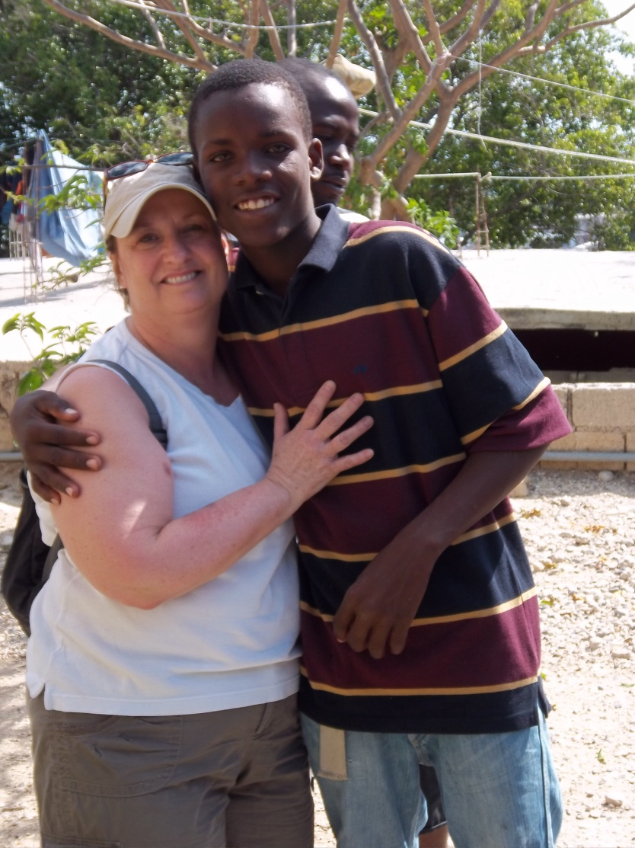
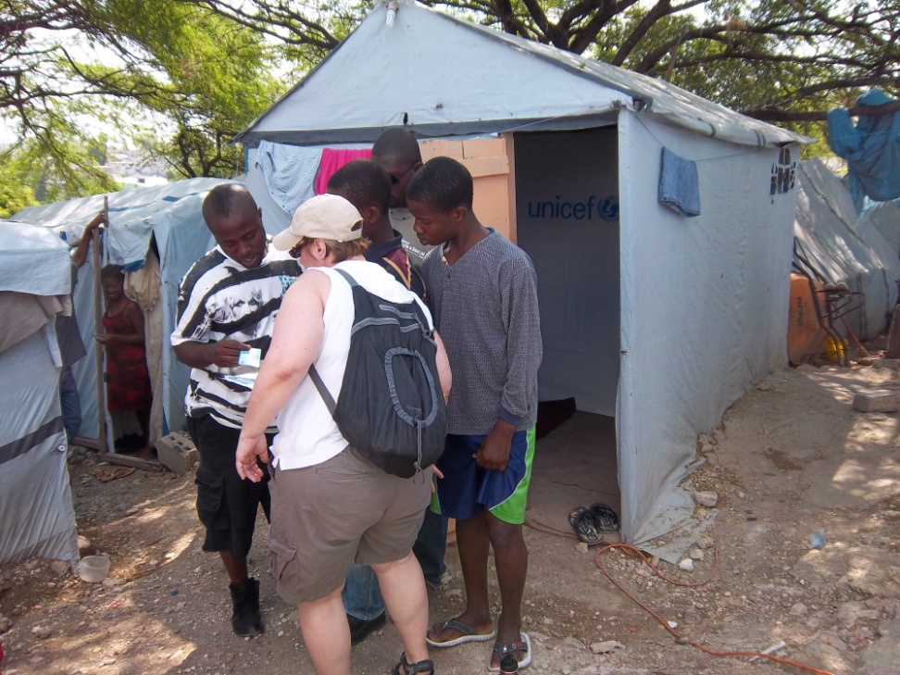
Kirby and His Tent (very neat)

Slide 16
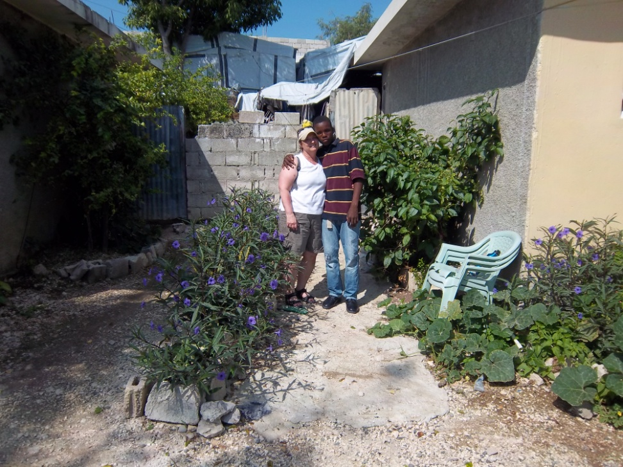
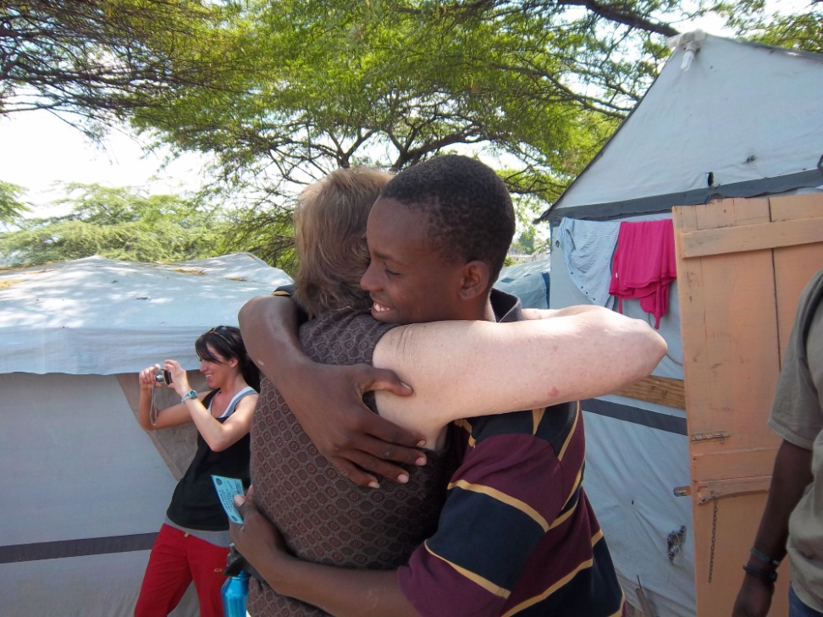
Hugs are always welcome!

Slide 17
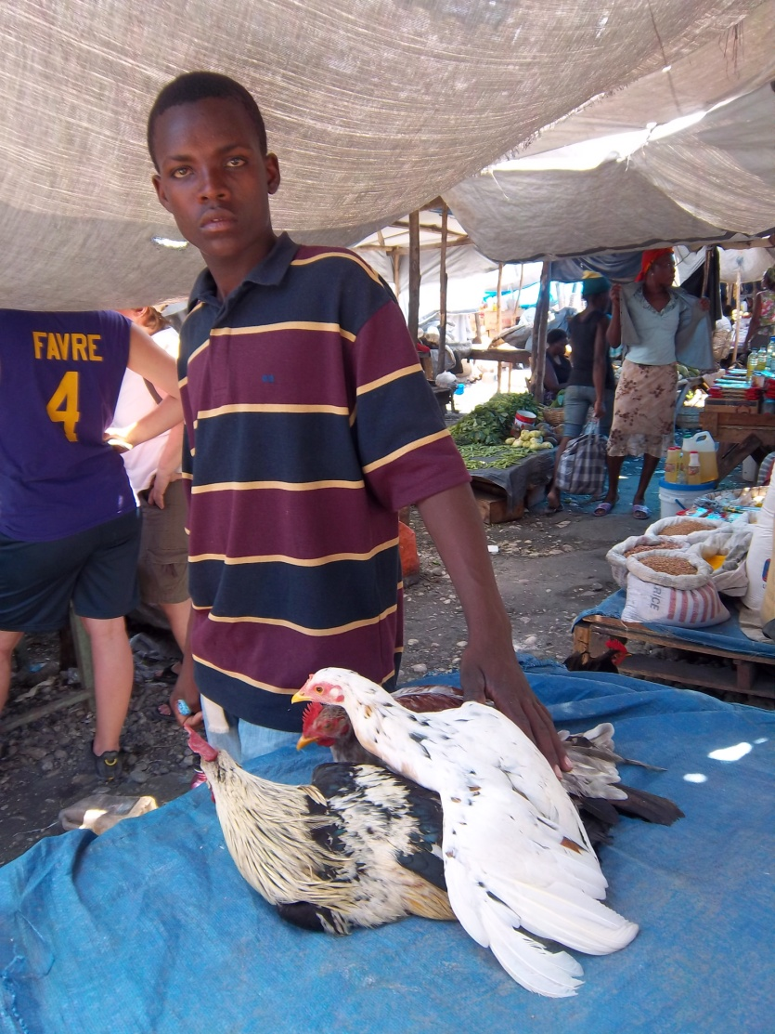
Kirby with his chickens

Slide 18
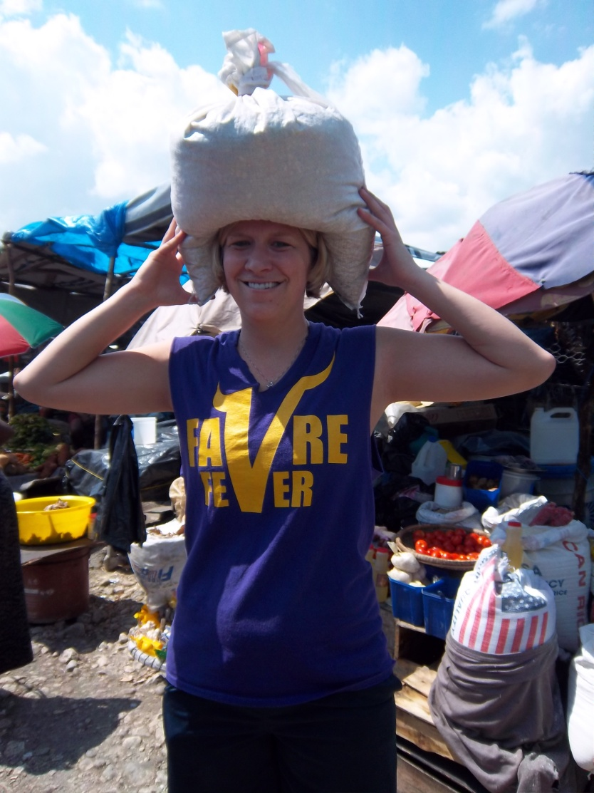
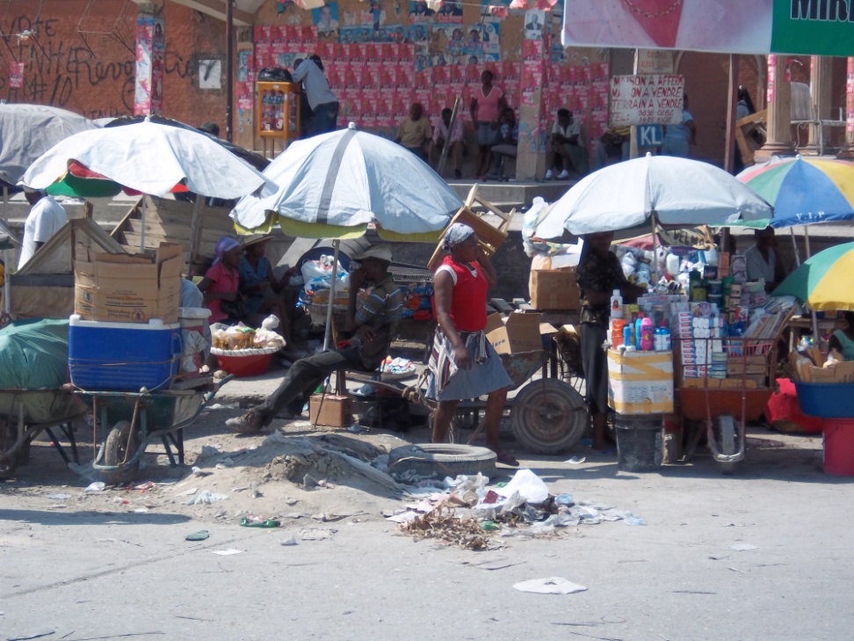
The Market and the Blan (white)

Slide 19
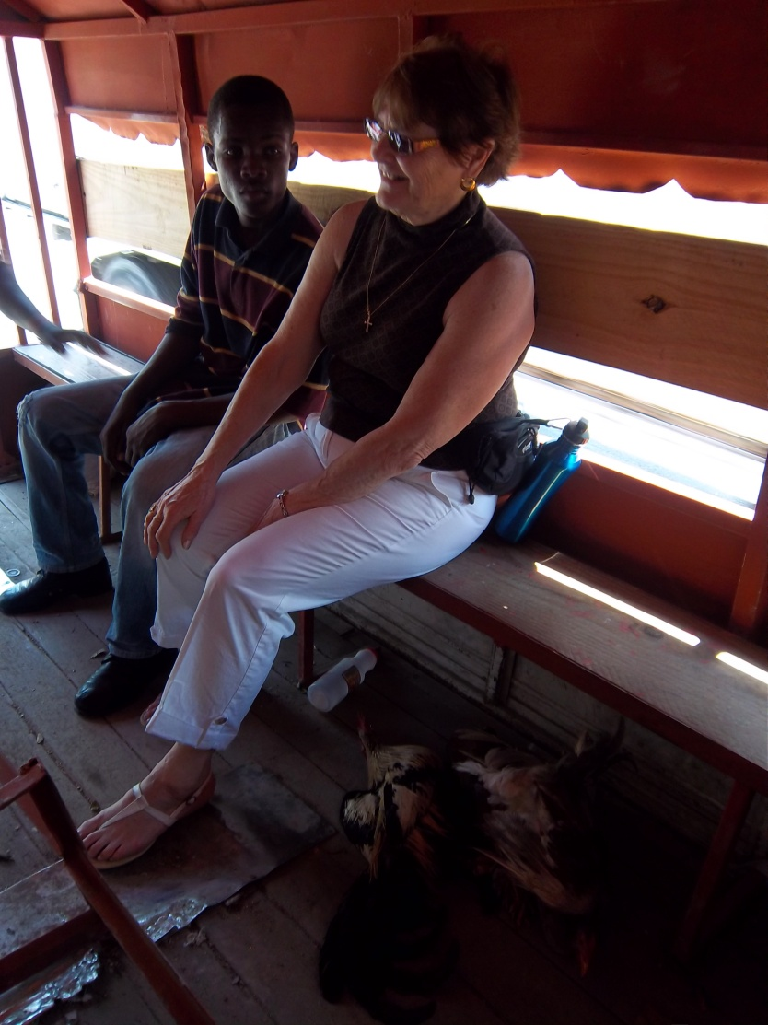
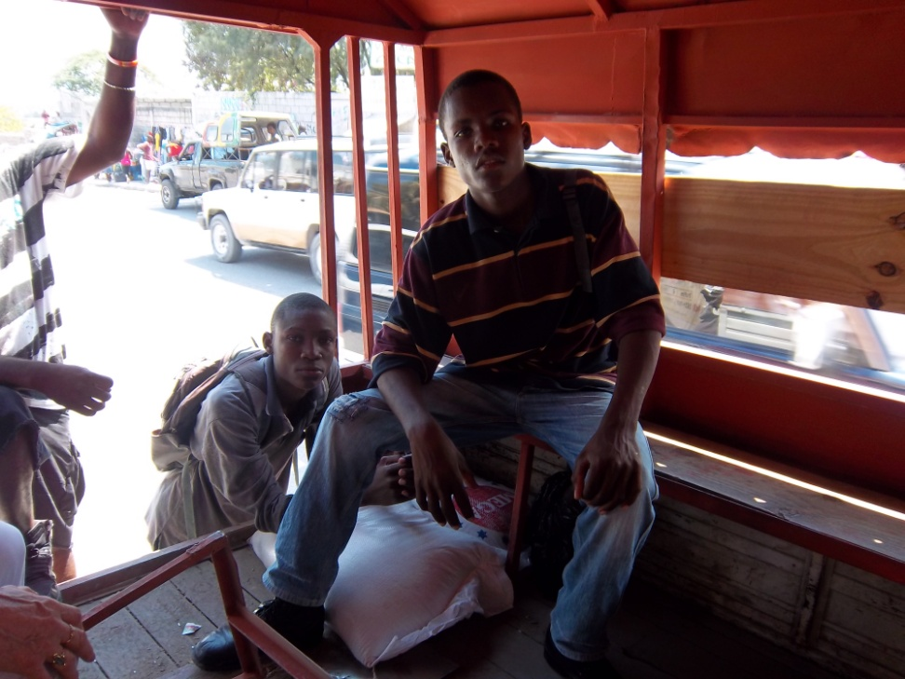
Traveling with Kirby and his Chickens & Chicken Feed

Slide 20
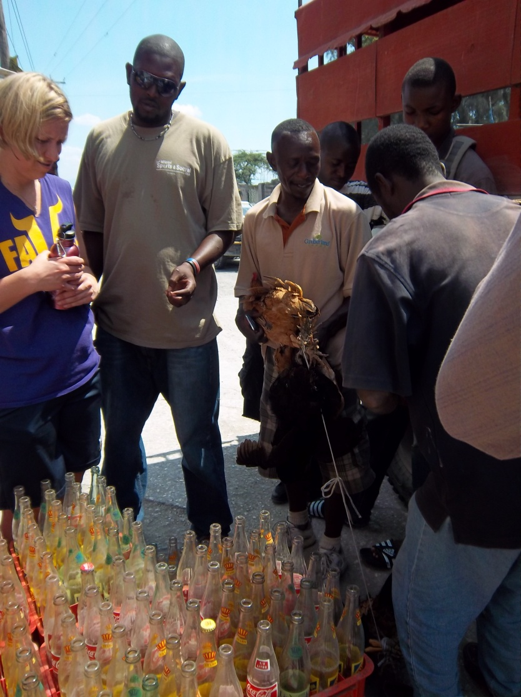
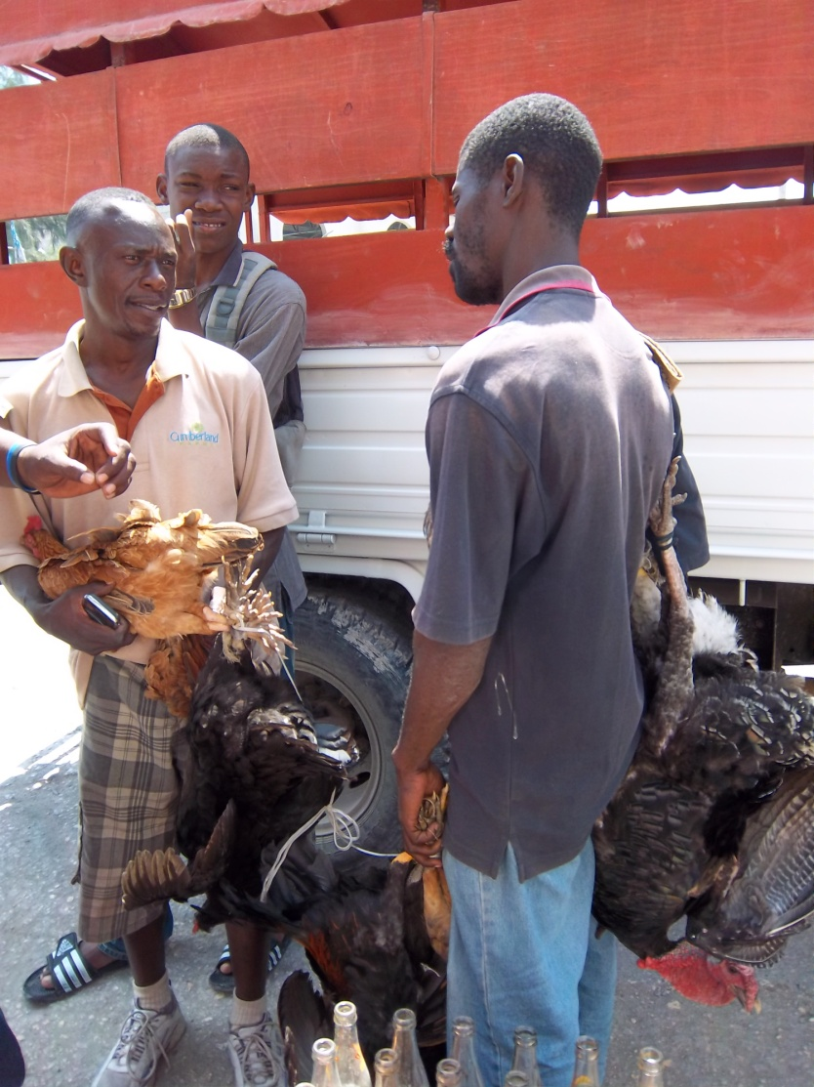
Purchasing Kalipso’s Chickens

Slide 21
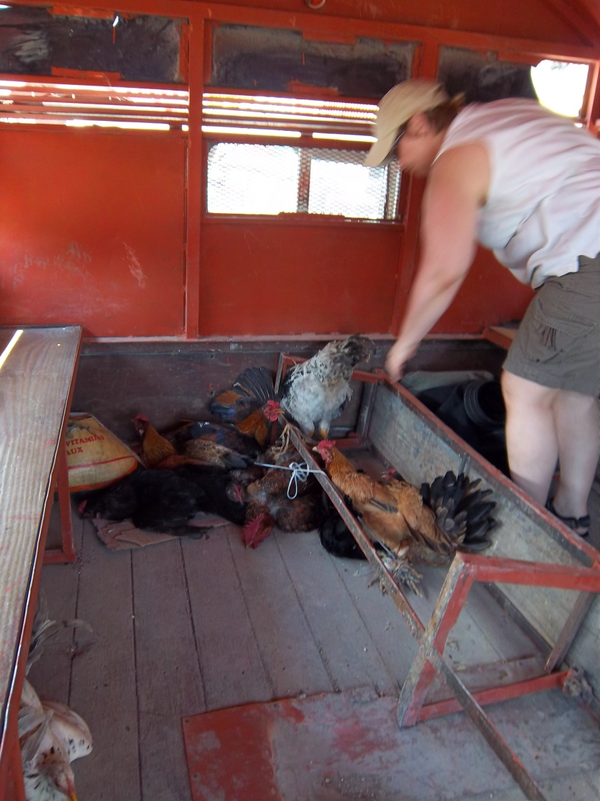
Checking on the Chickens!

Slide 22
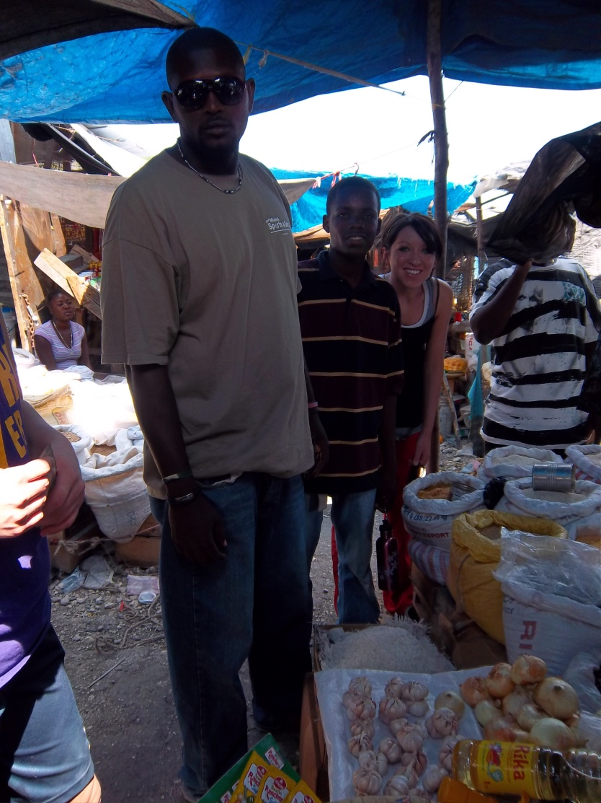
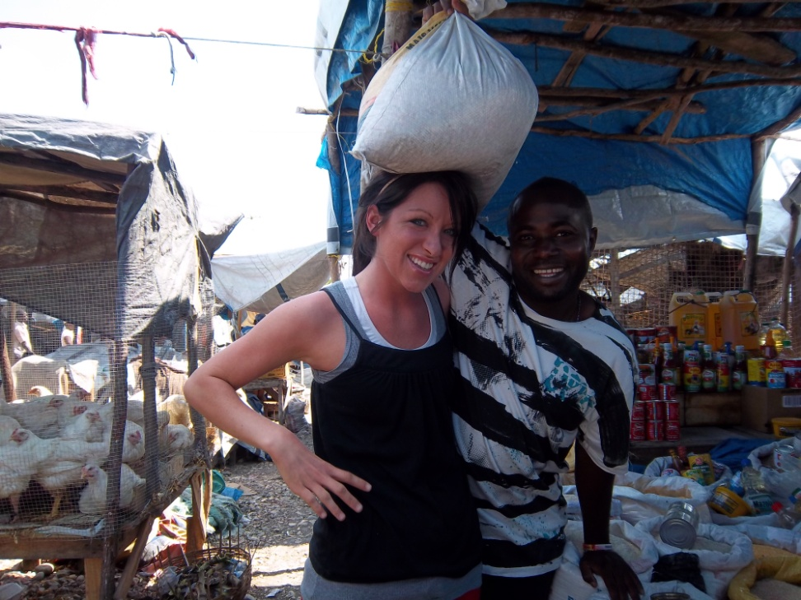
Scenes from the Market!

Slide 23
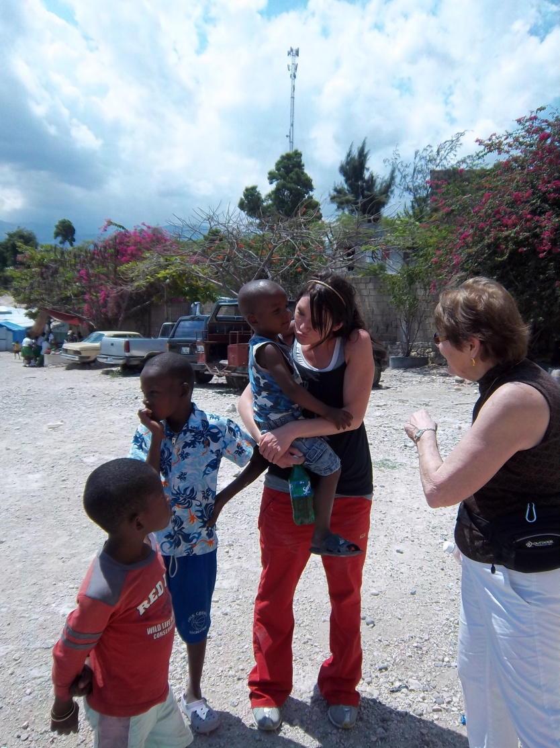
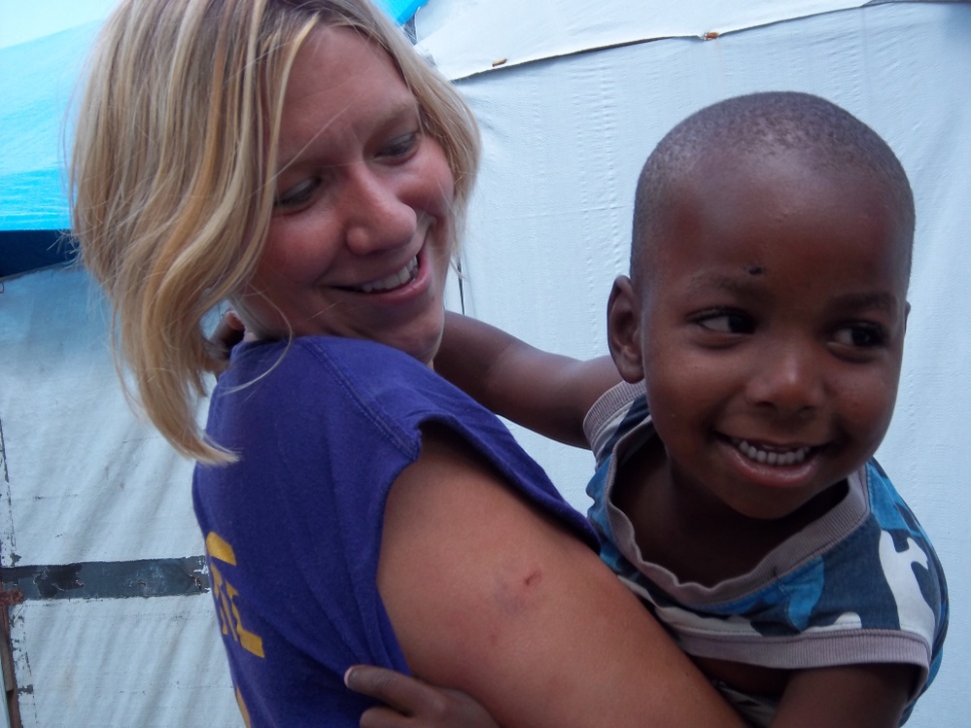
Friends at the AFCA Tent City

Slide 24
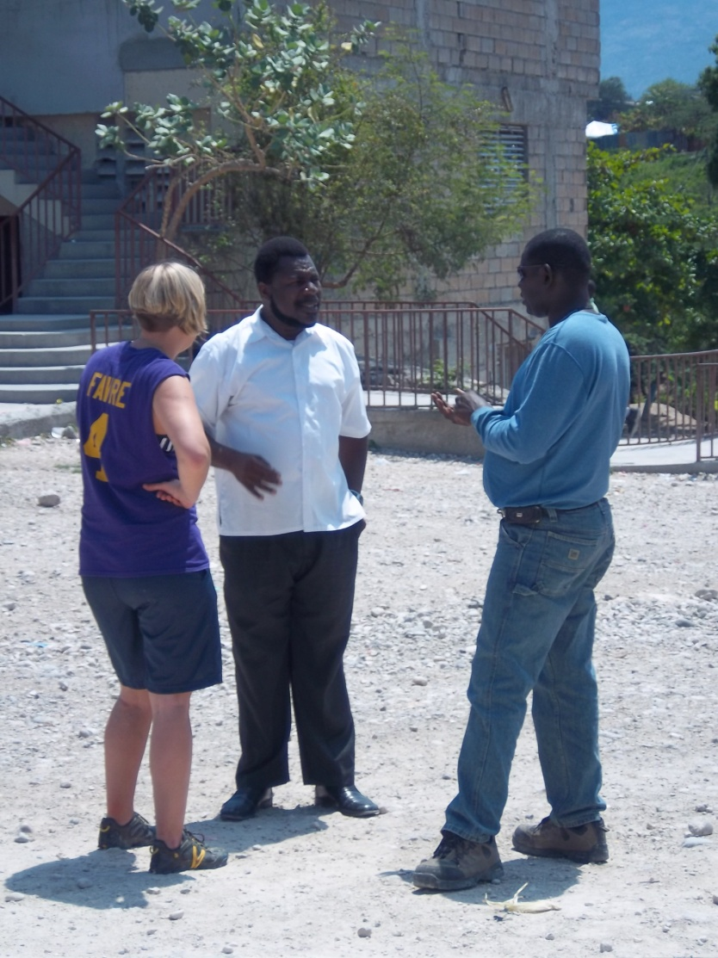
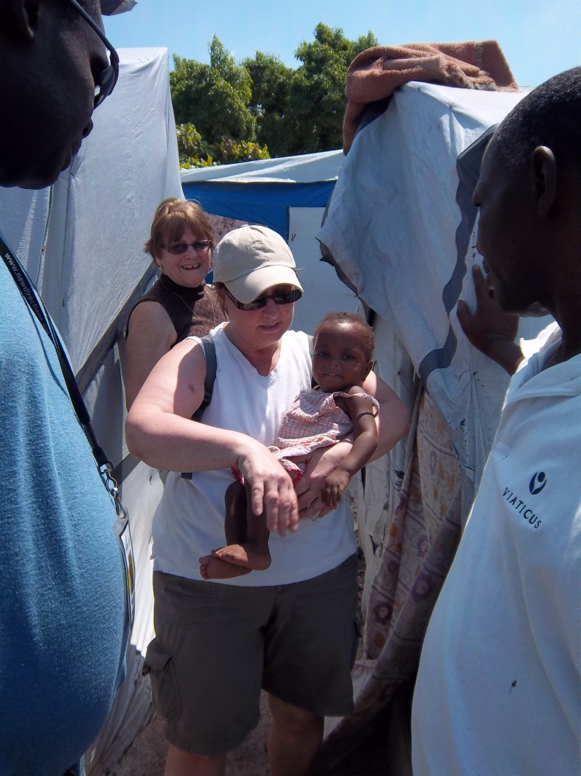
Pastor Renes (AFGA Tent City School in the background) the Twins

Slide 25
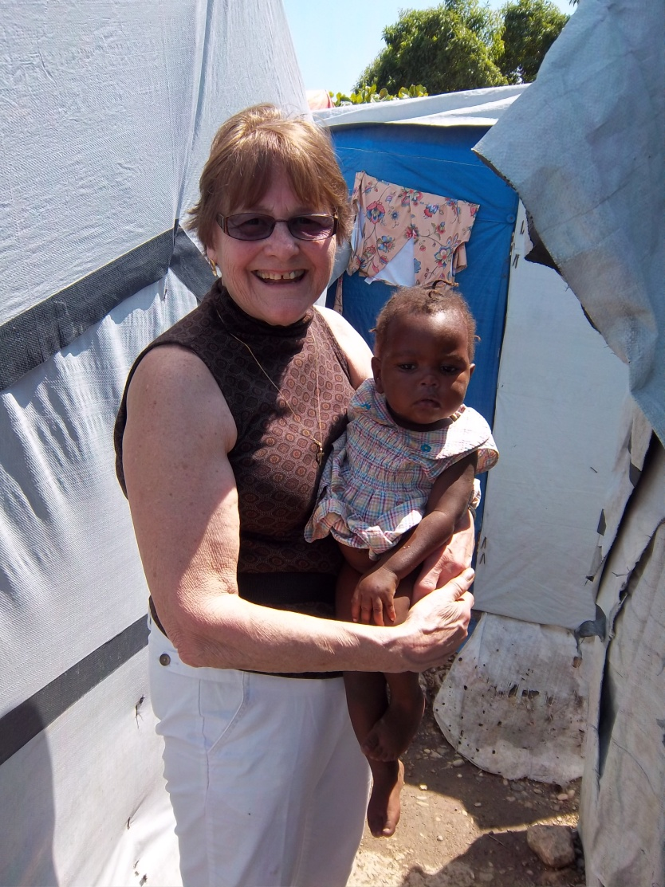
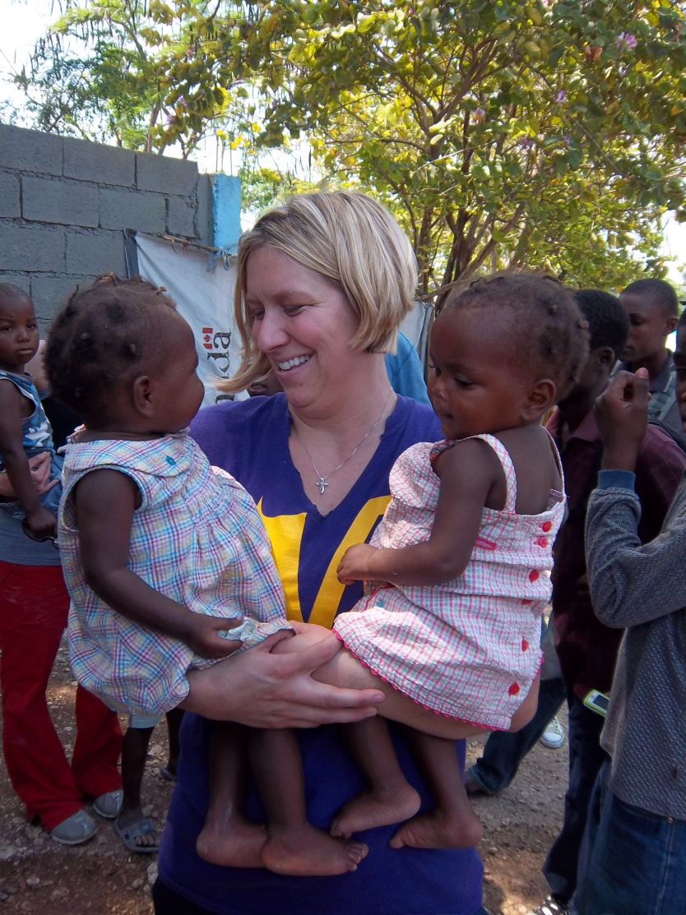
The Twins from the Tent!

Slide 26
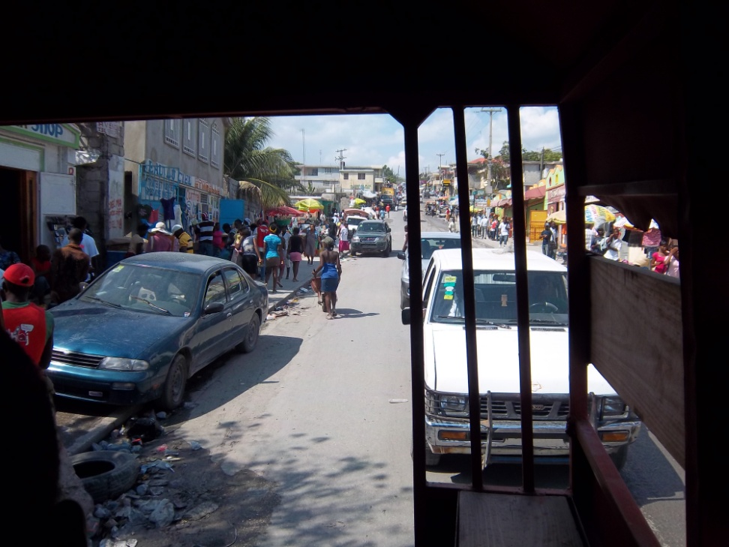
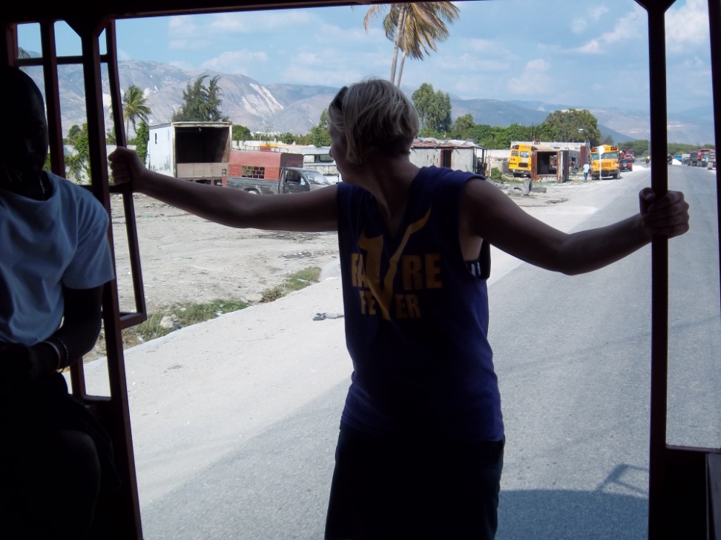
Travel In Haiti

Slide 27
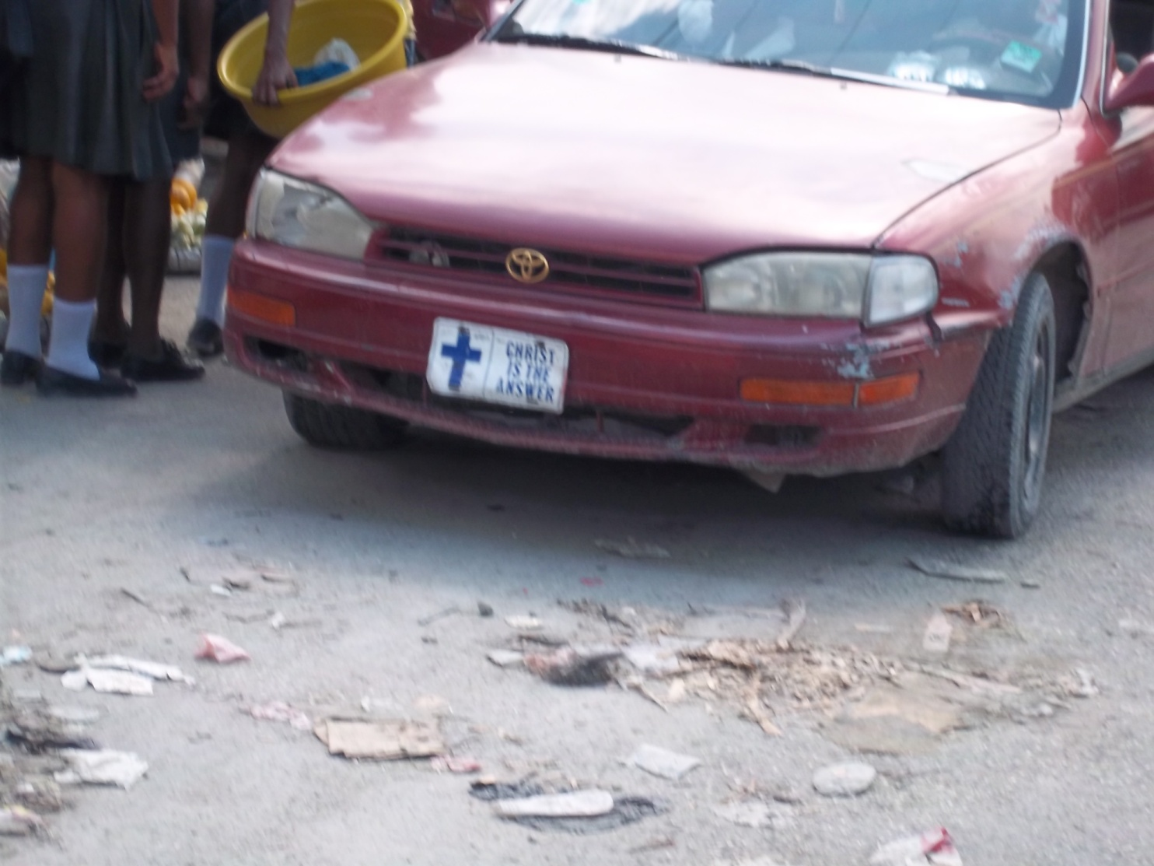
License Plate in Port Au Prince

Slide 28
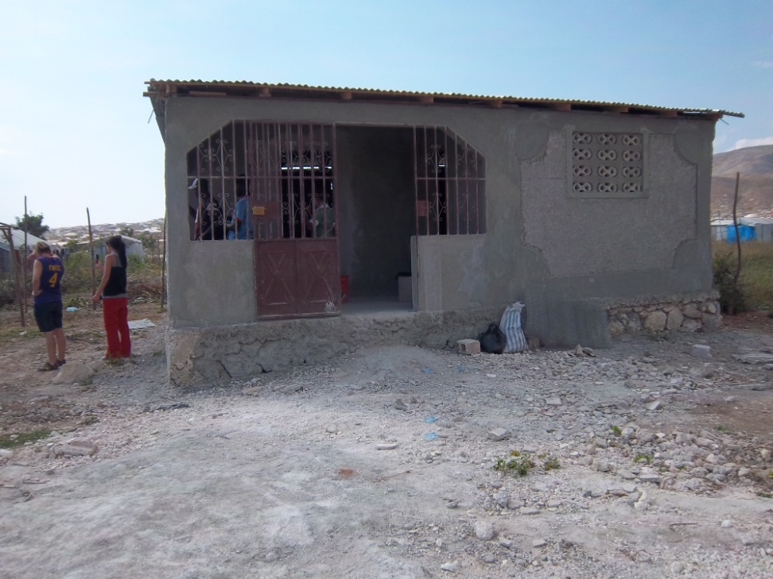
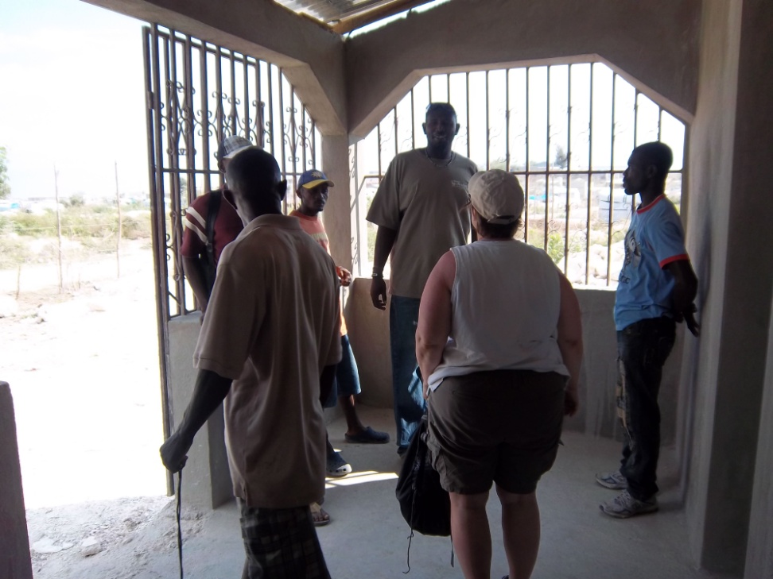
Kalipso’s House (built with Mission Team support)

Slide 29
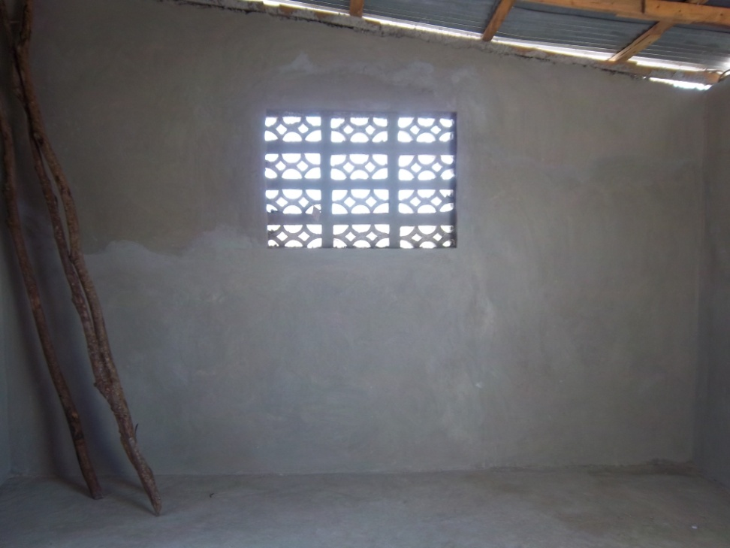
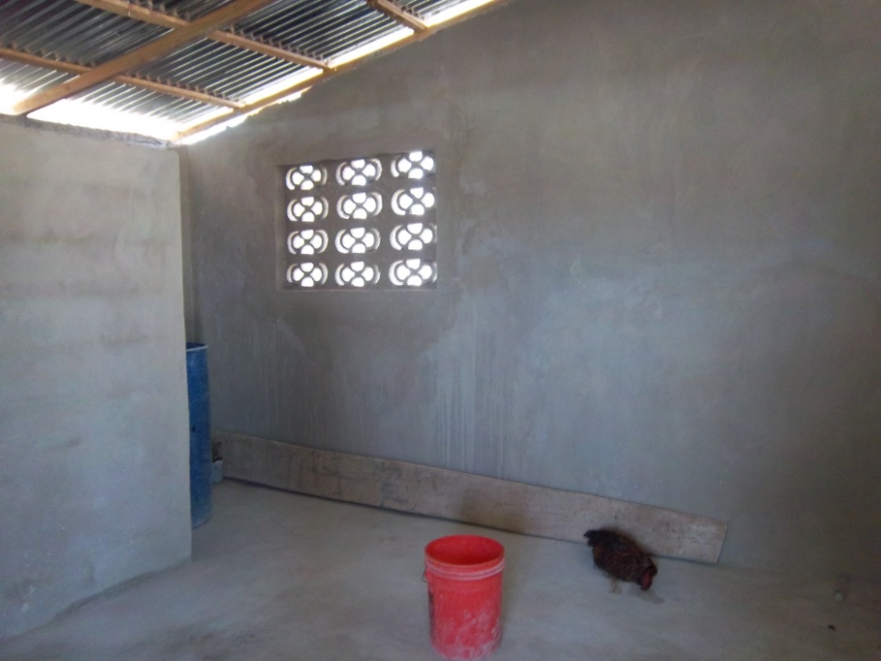
Rooms in the House

Slide 30
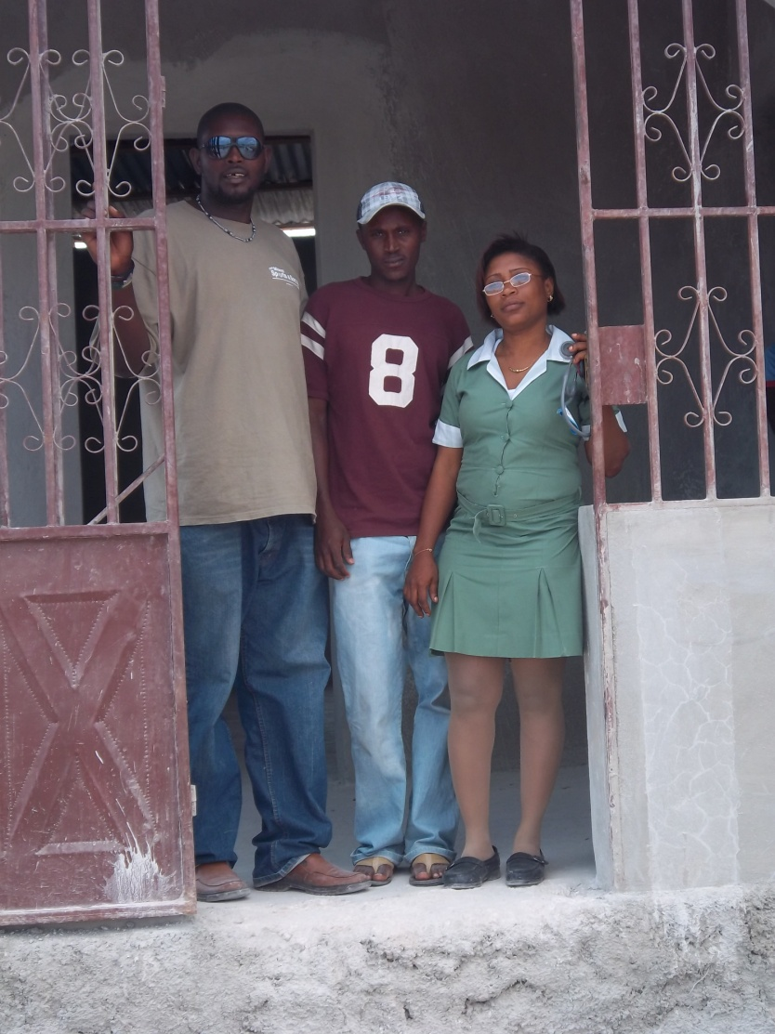
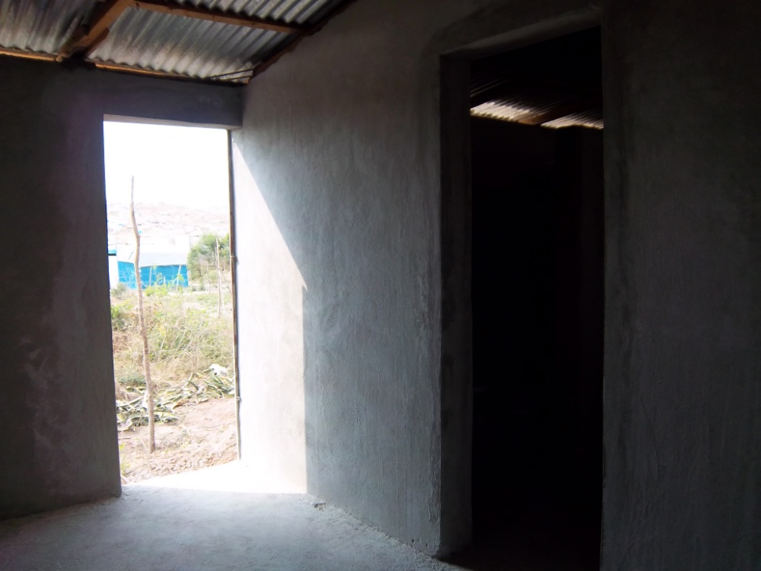
Kalipso and his family

Slide 31

The Start of the Chicken Coop

Slide 32

Travel to St Marc

Slide 33

YWAM St. Marc, Haiti
During our stay at YWAM, we spent two days canvassing the village of Timonette for children that were not attending school, because the parents cannot afford to send them. We expected there would be about 130, however we found there were 500 or more in the small village. We would like to be able to find sponsors for these children. The cost to send a child to school , is $350 for one school year.

Slide 34


Children Not Attending School

Slide 35


More Children Not Attending School

Slide 36


More Children

Slide 37

Taxi in Haiti

Slide 38


Children at the Aids Orphanage

Slide 39


Fun Time for Children

Slide 40


Aids Orphanage Group & Friend

Slide 41


One of two bunkbeds - table & chairs purchased for the Orphanage

Slide 42

Goodbye from the Aids Orphanage

Slide 43

Back to AFCA Tent City
We returned to AFCA Tent City to see how Kirby was doing with his chickens . He has built his chicken coop. Also, to see Blondie the 80 year old lady we had met in August and to distribute toys and clothing to the children.

Slide 44


Blondie (cleans shoes to sell at marketplace)

Slide 45


Distributing Clothing at Pastor Renes’ Church

Slide 46


Enjoying The Toys

Slide 47


The clothes look great!

Slide 48

Looks Great & fits well!
This girl was so happy with her T-shirt she had received with the clothing distribution. She went back to her tent and put it on so we could see it. She looked so nice in it.

Slide 49

Pastor Renes Deciere with his AFCA School in the background

Slide 50
The Great Commission
Jesus said, “Therefore go and make disciples of all nations baptizing them in the name of the Father, Son and of the Holy Spirit.”
Matthew 28:16-20

